Slide 1

Aircraft Domain Security Enhancement
Demo: Sprint 1
By: Group 6
Anthony Johnson, Matthieu Privat, Charles Gilmore, Jacob Stephens, Allen Biagetti, Jorge Santos, Max Gorley, and Max Wilson
Notes:
Anthony:
The aircraft domain is a complex system containing many critical and non-critical systems used in flight. An aircrafts network can be split into three levels: the Aircraft Control Domain (ACD), the Airline Information Services Domain (AISD), and the Passenger Information and Entertainment Services Domain (PIESD). In this project, we hope to emulate the AISD network and potentially move towards connecting it with the ACD. Once these systems are set in place, we will investigate how these domains can be simulated, and tested for cybersecurity.

Slide 2
Design Considerations
Assumptions
QEMU easy set up
Windows compatibility
Open resources on aircraft network systems
General Constraints
Virtual network instead of physical
Funding, time, and limited group of people
Safety Constraints/Considerations
Pen-testing and malware safety
Zero-day attacks
SSH and Riddle IT
Notes:
Max W:
Due to the complexity and scale of the project there are several design considerations. Some of the main assumptions include _. There are also multiple constraints of the project due to this being the first year out of a multi-year project to continue after we graduate. Lastly are the safety constraints. Since this project’s main purpose is testing the security of an aircraft network, safety considerations are a key component. Considerations include _.

Slide 3
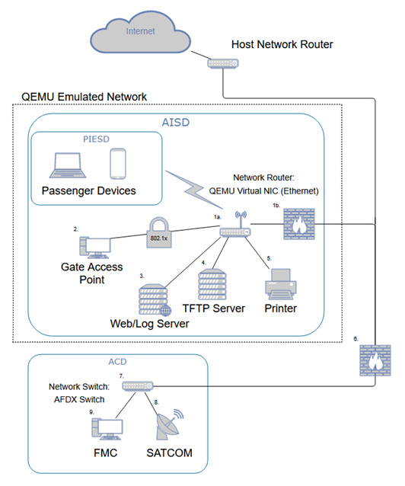
System Architecture & Breakdown
Emulation of Aircraft Network System
QEMU virtualization
Multiple nodes implemented
Software & hardware implementation
Penetration testing toolkit
Connects to emulated network
CTF: Red versus Blue teams
Github Repository: mwils1426/CS-490
Notes:
Anthony

Slide 4
Lessons Learned
Start small, don’t overdo each Sprint
More focus on documentation
Windows versus Linux OS
Working in a larger team
Working with outside partners
Notes:
- Matthieu claimed lol

Slide 5
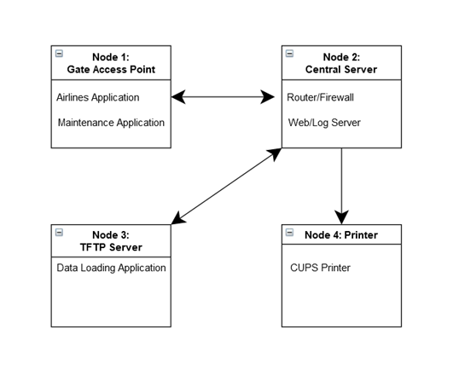
Project Timeline
Sprint 1:
Basic set up of aircraft network nodes and transfer of basic files/communication between systems
Sprint 2:
Start securing system
Start pentesting toolkit
Sprint 3:
Testing of both systems
“Poking holes in aircraft network”
Notes:
Max G

Slide 6


Demo Pics!

Slide 7
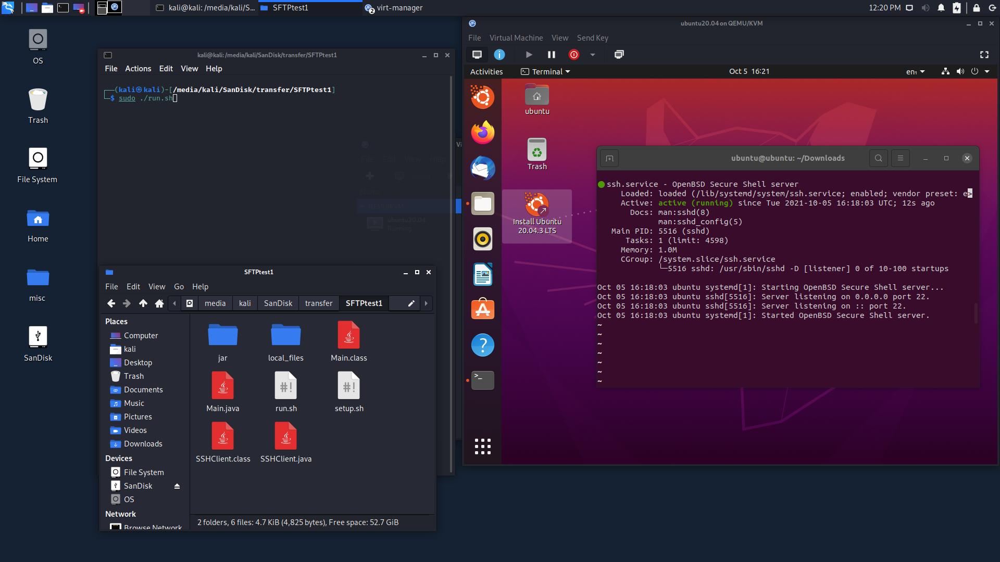
GAP Connection Test

Slide 8
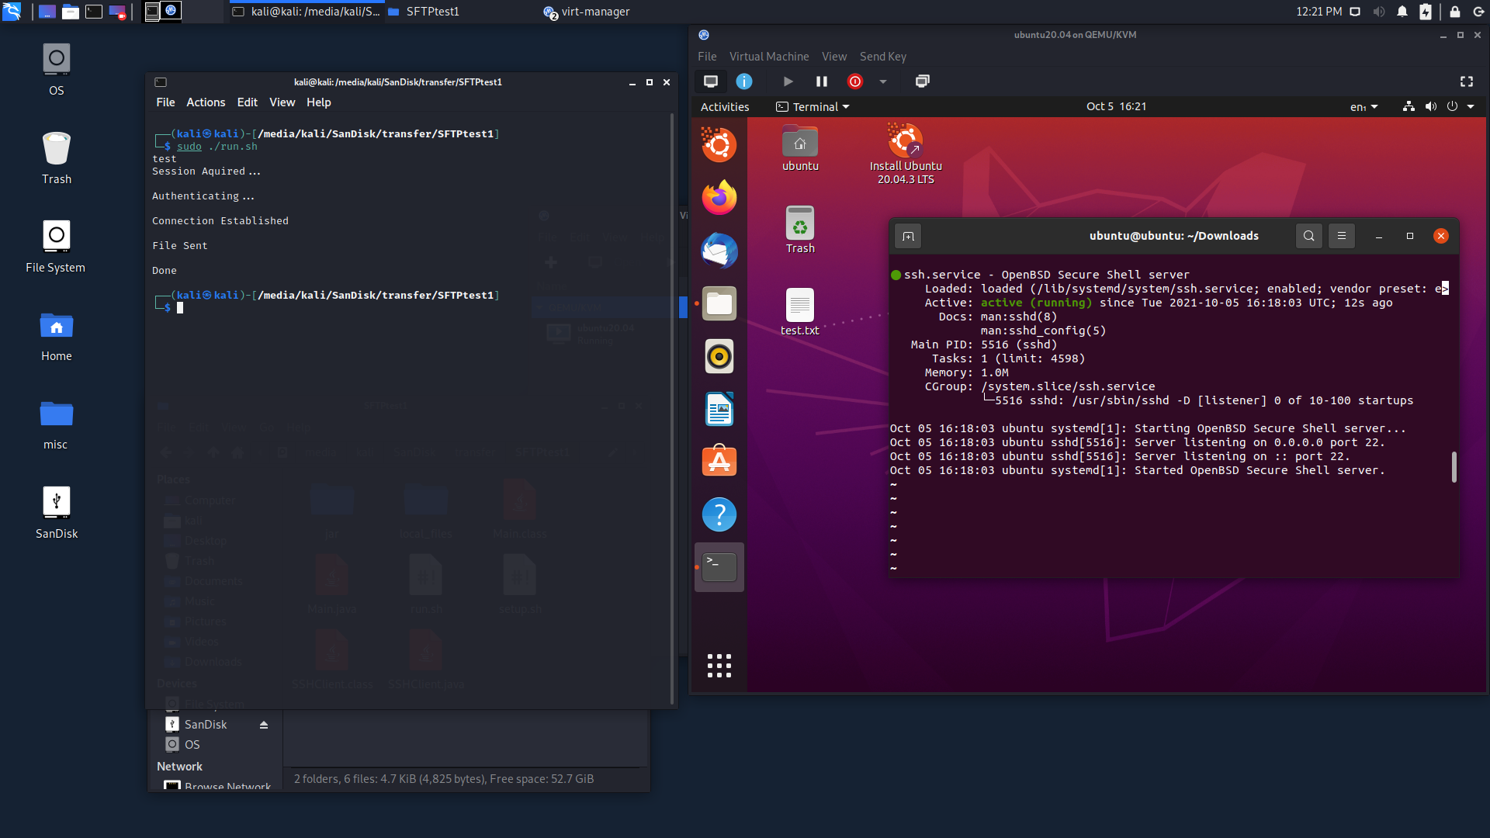
GAP Connection Test

Slide 9

Questions?

